Slide 1
A/B testing -or- Randomized controlled trial -or- Completely Randomized Designs
Matthew Wheler

Slide 2
In many cases, we have one factor with multiple different treatments that we control and we want to find out which is better (or worse).
We Need To:
Define the tests we are interested in making.
Determine the size of our sample using a power analysis.
Randomly assign the experimental unit to the treatment.
Run the experiment.
Analyze the data.
For now, we will assume 2 is done until we revisit this in the future.

Slide 3
Issues we will deal with for our experimental design:
Multiple testing
When we specify a specific α and do multiple testing we are not actually testing at that α for ALL tests.
2. What effect is significant?
- Suppose we are looking at increase in spending and there is a true effect of $0.01, do we really care?
- How much variability can we expect?
3. If we design an experiment, how many “experimental units” do we need to 1 and 2? That is how much do we want to spend to see 2 with “reasonable probability?

Slide 4
Example 1
Let’s analyze at the full dataset we looked at last class
0 μg/L | 20 μg/L | 40 μg/L
60 | 58 | 40
90 | 74 | 58
74 | 50 | 25
82 | 65 | 30
 | 68 | 42

Slide 5
Our Plan:
Contrasts:
Difference between 0 µg/L and 20 µg/L
Difference between 0 µg/L and 20 µg/L
Difference between 0 µg/L , 20 µg/L -vs- 40 µg/L
Overall Test Level:
α = 0.05

Slide 6
/* data for example 2
in Lecture 1*/
data dubia_exp;
input dose age;
cards;
0 60
0 90
0 74
0 82
20 58
20 74
20 50
20 65
20 68
40 40
40 58
40 25
40 30
40 42
;

Slide 7
/* Using proc glm to answer questions
for a 1-way anova*/
proc glm data = dubia_exp;
class dose; /*treatment effects*/
model age = dose; /*main model*/
lsmeans dose/cl stderr; /*get model based estimates
of the effect
-cl specifies we are requesting
confidene limts*/
estimate '0ug -vs- 20ug' dose 1 -1 0; *ANOVA BASED ESTIMATES;
estimate '0ug -vs- 40ug' dose 1 0 -1;
estimate '0ug, 20ug -vs- 40ug' dose 0.5 0.5 -1; *must add to 0;
contrast '0ug -vs- 20ug' dose 1 -1 0; *ANOVA BASED TESTING;
contrast '0ug -vs- 40ug' dose 1 0 -1;
contrast '0ug, 20ug -vs- 40ug' dose 0.5 0.5 -1; *must add to 0;
run;
quit;

Slide 8
Source | DF | Sum of Squares | Mean Square | F Value | Pr > F
Model | 2 | 3297.857143 | 1648.928571 | 12.23 | 0.0016
Error | 11 | 1483.000000 | 134.818182
Corrected Total | 13 | 4780.857143
Estimates the model variance.
This says there is something going on,
it doesn’t say what. More on this later.

Slide 9
Model Estimates
dose | age LSMEAN | 95% Confidence Limits
0 | 76.500000 | 63.722045 | 89.277955
20 | 63.000000 | 51.571050 | 74.428950
40 | 39.000000 | 27.571050 | 50.428950
These are essentially the mean estimates, but
as our models get more complicated they will not be!
Use lsmeans to get the model based estimate.
dose | age LSMEAN | Standard Error | Pr > |t|
0 | 76.5000000 | 5.8055616 | <.0001
20 | 63.0000000 | 5.1926522 | <.0001
40 | 39.0000000 | 5.1926522 | <.0001

Slide 10
Model Based Estimated Differences
Parameter | Estimate | Standard Error | t Value | Pr > |t|
0ug -vs- 20ug | 13.5000000 | 7.78897823 | 1.73 | 0.1110
0ug -vs- 40ug | 37.5000000 | 7.78897823 | 4.81 | 0.0005
0ug, 20ug -vs- 40ug | 30.7500000 | 6.49081519 | 4.74 | 0.0006

Slide 11
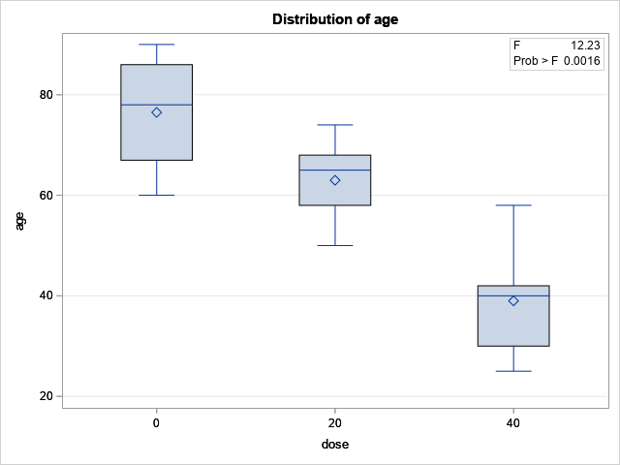
Contrasts
Contrast | DF | Contrast SS | Mean Square | F Value | Pr > F
0ug -vs- 20ug | 1 | 405.000000 | 405.000000 | 3.00 | 0.1110
0ug -vs- 40ug | 1 | 3125.000000 | 3125.000000 | 23.18 | 0.0005
0ug, 20ug -vs- 40ug | 1 | 3025.800000 | 3025.800000 | 22.44 | 0.0006

Slide 12
So we can conclude individually at α = 0.05:
There is not enough evidence to reject the null that 20µg of copper leads to reduced life spans vs. 0µg of copper.
40µg decreases the live span vs 0µg
40µg decreases the life span vs 0 and 20µg
Organic food has problems too. Copper is the number 1 pesticide used for organic food.
Note: I said individually, that is when we test only one hypothesis the type I error rate is controlled to be our 5% level. When we have multiple tests it is actually higher than that.

Slide 13
On Multiple Comparisons:
It is important to think about what setting α = 0.05 means.
It means that BY CHANCE if nothing is going on I should see a ‘significant’ result 5% of the time.
So what happens if I do multiple tests with each test being independent?

Slide 14
Number of Tests | Probability of Spurious Result
1 | 0.05
2 | 0.10
3 | 0.14
4 | 0.19
5 | 0.23
1 | 0.05
6 | 0.26
7 | 0.30
8 | 0.34
9 | 0.37
10 | 0.40
20 | 0.64
30 | 0.79
40 | 0.87
50 | 0.92

Slide 15
That is if nothing is going on and I do a “bunch of tests” after a while I am almost guaranteed to report a significant finding even when nothing is happening!
Most ‘science’ (especially medical and psychology) does this – it is why I never ever trust a report about ‘health science’ news.
It is why you have to plan your analyses before hand!
It is also why you have to adjust for multiple comparisons!

Slide 16
Adjusting for multiple comparisons
First Way Bonferroni adjustment:
Benefits: Can be used in any setting we deal with in this class
Negatives: If you are doing a lot of comparisons it kills power. Thus you need a ton of resources to conclude anything : use with caution, or if sampling is cheap, or if your boss doesn’t care about money.

Slide 17
Bonferroni Adjustment
Idea: We assume that the each test is independent and we have a fixed Type I error rate α, and that we are doing k tests. We want to control the probability that all tests combined have a type I error rate of at least α. This can be done by making each individual test at α* = α/k.
For Example 1 this means that our individual tests are at an α* = 0.05/3, which is 0.017

Slide 18
Revisiting this problem with Bonferroni adjustment.
Contrast | DF | Contrast SS | Mean Square | F Value | Pr > F
0ug -vs- 20ug | 1 | 405.000000 | 405.000000 | 3.00 | 0.1110
0ug -vs- 40ug | 1 | 3125.000000 | 3125.000000 | 23.18 | 0.0005
0ug, 20ug -vs- 40ug | 1 | 3025.800000 | 3025.800000 | 22.44 | 0.0006
These tests are significant at values less than 0.017, which implies that
we can reject the null at our given Type I error rate and still be “safe.”

Slide 19
Adjusting for multiple Comparisons
Second Way Tukey-Kramer adjustment:
Benefits: Very useful for finding differences between all possible comparisons between means.
Negatives: Can only be used in this situation, you can’t compare multiple groups, and when you have data/analyses that are not normal you can’t use it.

Slide 20
Tukey-Kramer Adjustment
Idea: If there is nothing going on (i.e. under the null) we can assume that the differences between means are essentially normal random variables with mean zero and some variance. Then the distance between the maximum mean and the minimum mean, divided by the standard deviation, has some distribution. We call this the “Studentized range distribution,” which can be thought of as just another distribution like the T-distribution that can be used for testing purposes. This distribution, by definition, controls for multiple testing.

Slide 21
Doing this in SAS
/* Using proc glm to answer questions
for a 1-way anova*/
proc glm data = dubia_exp;
class dose; /*treatment effects*/
model age = dose; /*main model*/
lsmeans dose/cl stderr adjust=tukey; /*get model based estimates
of the effect
-cl specifies we are requesting
confidene limts
-tukey adjusts for multiple comparisons*/
run;
quit;

Slide 22
New output
Least Squares Means for effect dose Pr > |t| for H0: LSMean(i)=LSMean(j) Dependent Variable: age
i/j | 1 | 2 | 3
1 |  | 0.2368 | 0.0014
2 | 0.2368 |  | 0.0189
3 | 0.0014 | 0.0189
Least Squares Means for Effect group
i | j | Difference Between Means | Simultaneous 95% Confidence Limits for LSMean(i)-LSMean(j)
1 | 2 | -9.750000 | -25.937197 | 6.437197
1 | 3 | -36.125000 | -52.312197 | -19.937803
2 | 3 | -26.375000 | -42.562197 | -10.187803

Slide 23
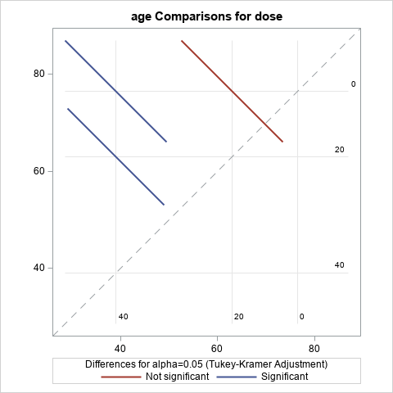

Slide 24
With the Tukey-Kramer adjustment, we get the same result as with the Bonferonni adjustment, but this isn’t always the case.

Slide 25
Adjusting for multiple comparisons
Third Way: Control using an ANOVA (not really an adjustment):
Benefits: The ANOVA controls the overall error for a factor, so you are saying something is going on with that factor:
Negatives: It isn’t really controlling the error for individual tests between treatments in that factor. Use as a last resort.

Slide 26
ANOVA
Idea: The ANOVA test is an overall test for a given factor. It says some treatment in the factor is different, but it doesn’t say which one. Use this to narrow down the options, and report the most ‘significant’ tests individually. You are assure through your ANOVA that something is happening with the specified Type I error rate, you just don’t know what.

Slide 27
ANOVA Table
Source | DF | Sum of Squares | Mean Square | F Value | Pr > F
Model | 2 | 3297.857143 | 1648.928571 | 12.23 | 0.0016
Error | 11 | 1483.000000 | 134.818182
Corrected Total | 13 | 4780.857143
Something is going on.

Slide 28
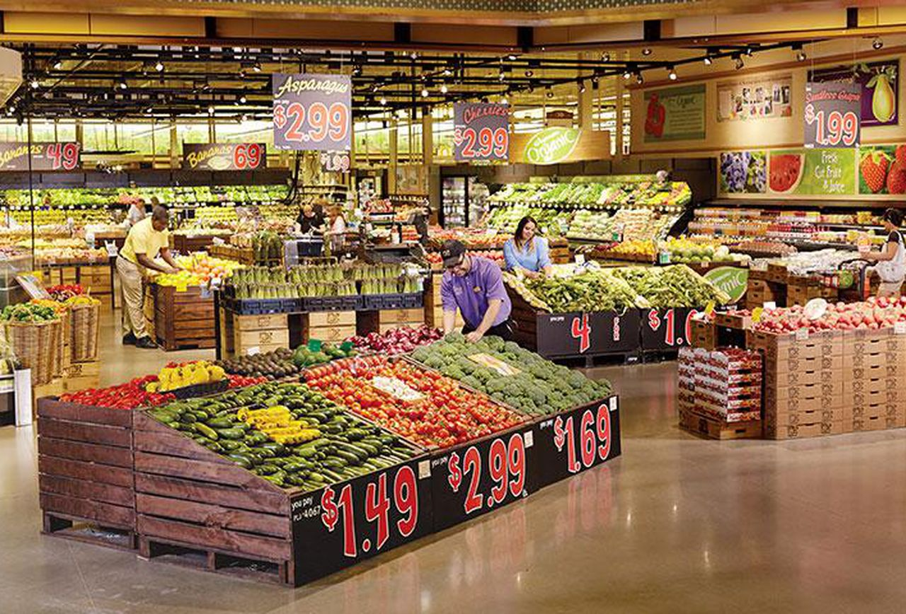
Example 2
A marketing firm is considering two different incentives to increase a grocery store’s frequent shopper’s weekly purchases. The first is a mail marketing campaign and the second is a campaign that incentivizes purchases through a new smartphone app. We are interested in finding out if either of these marketing approaches will increase spending.

Slide 29
Tests
Before we analyze the data, we must define what we are interested in:
We have 3 treatments:
Doing nothing.
Mail marketing.
App Marketing.
What are the comparisons we are interested in making?

Slide 30
Test 1: Doing nothing –vs- mail marketing
Test 2: Doing nothing –vs- new app
Test 3: Doing nothing or mail marketing -vs- new app
The first two tests are similar to what you might to with a t-test.
The third test compares the first two treatments to the newly developed app.
Each one is called a contrast.

Slide 31
/*data marketing
Example 2 data*/
data marketing;
input group spent @@;
cards ;
1 100 1 110 1 92
1 122 1 118 1 98
1 130 1 110 2 115
2 121 2 110 2 130
2 142 2 108 2 112
2 120 3 125 3 140
3 153 3 142 3 130
3 162 3 157 3 160
;
/*test the marketing data
using an ANOVA based glm model*/
proc glm data = marketing;
class group; * types of groups;
model spent = group; *model;
lsmeans group/cl stderr adjust=tukey; *multiple mean comparisons;
contrast 'Nothing -vs- Mail' group 1 -1 0; *ANOVA BASED TESTING;
contrast 'Nothing -vs- App ' group 1 0 -1; *For contrasts;
contrast 'Nothing, Mail -vs- App' group 0.5 0.5 -1;
run;

Slide 32
ANOVA
Something is going on:
Source | DF | Sum of Squares | Mean Square | F Value | Pr > F
Model | 2 | 5588.583333 | 2794.291667 | 16.94 | <.0001
Error | 21 | 3464.375000 | 164.970238
Corrected Total | 23 | 9052.958333

Slide 33
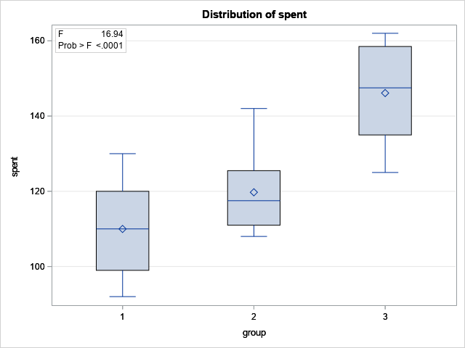

Slide 34
Tukey’s Difference
group | spent LSMEAN | Standard Error | Pr > |t| | LSMEAN Number
1 | 110.000000 | 4.541066 | <.0001 | 1
2 | 119.750000 | 4.541066 | <.0001 | 2
3 | 146.125000 | 4.541066 | <.0001 | 3
Least Squares Means for effect group Pr > |t| for H0: LSMean(i)=LSMean(j) Dependent Variable: spent
i/j | 1 | 2 | 3
1 |  | 0.3029 | <.0001
2 | 0.3029 |  | 0.0014
3 | <.0001 | 0.0014

Slide 35
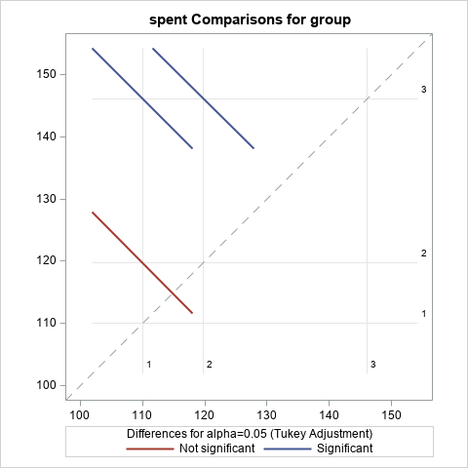

Slide 36
Contrast | DF | Contrast SS | Mean Square | F Value | Pr > F
Nothing -vs- Mail | 1 | 380.250000 | 380.250000 | 2.30 | 0.1439
Nothing -vs- App | 1 | 5220.062500 | 5220.062500 | 31.64 | <.0001
Nothing, Mail -vs- App | 1 | 5208.333333 | 5208.333333 | 31.57 | <.0001
Bonferroni test is ok

Slide 37
The contrast statement
The contrast statement is designed to compare means across groups:
contrast 'Nothing -vs- Mail' group 1-1 0; *ANOVA BASED TESTING;
contrast 'Nothing -vs- App ' group 1 0 -1; *For contrasts;
contrast 'Nothing, Mail -vs- App' group 0.5 0.5 -1;

Slide 38
First we must recognize that there are 3 group means we are interested in:
1) Money spent doing nothing µ₁
2) Money spent with direct mail marketing µ₂
3) Money spent with new mobile app µ₃
Let’s break down the first question:
What is the difference between a customer’s spending habits when I do not directly market to them (µ₁) in comparison to mail marketing (µ₂)?
As an equation, this is: 1µ₁+(-1)µ₂

Slide 39
The contrast statement says:
contrast 'Nothing -vs- Mail' group 1 -1 0;
1µ₁+(-1)µ₂+(0)µ₃
I am literally subtracting the mean from group 1 to the mean of group 2
For a contrast to be correct, my numbers must sum to zero.

Slide 40
Now let’s think about the following statement:
Is there a difference between a customer’s spending habits when I do not directly market to them (µ₁) or I directly mail marketing (µ₂) in comparison to them using the new app (µ₃)?
One might be tempted to do this: (1)µ₁+(1)µ₂ +(-1)µ₁
However, it is wrong. We are not accounting for the fact I am comparing one group to two groups. Instead:
(1)µ₁+(1)µ₂ +(-2)µ₁
(0.5)µ₁+(0.5)µ₂ +(-1)µ₁
Both are correct, and will give the same answer.

Slide 41
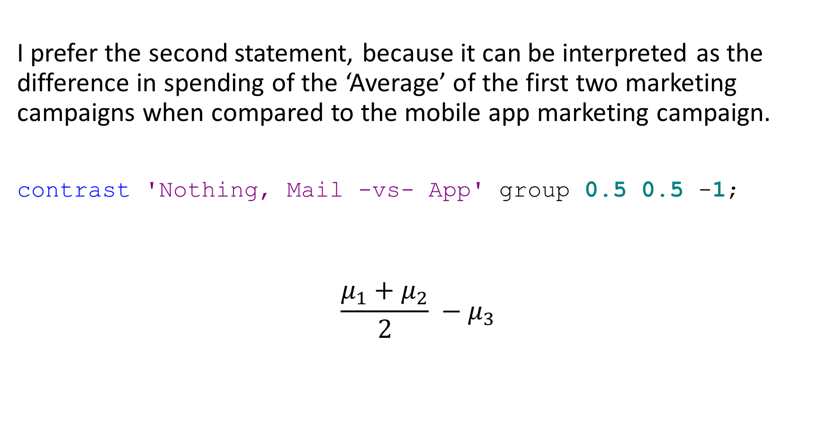
I prefer the second statement, because it can be interpreted as the difference in spending of the ‘Average’ of the first two marketing campaigns when compared to the mobile app marketing campaign.
contrast 'Nothing, Mail -vs- App' group 0.5 0.5 -1;
$$\frac{μ_{1}+μ_{2}}{2} −μ_{3}$$

Slide 42
Things we are missing still with A/B testing:
What happens when we have ‘extra variables’ that we can not randomize.
How is SAS coding things is called a design matrix. Unfortunately different PROCS do different things with the design matrix. We have to disentangle things so we can go forward and no what we are doing.

